Slide 1
Success Criteria
E-Learning-Website Success Criteria
The project that finishes in scheduled time, within the allocated budgets and which satisfies the customer requirements.
All high-priority functionality defined in the requirements specification is delivered in the first release.
Open-sources are optimized closely, less complexity, improving quality of the system.
The estimated number of residual defects does not exceed 5 per function point.

Slide 2
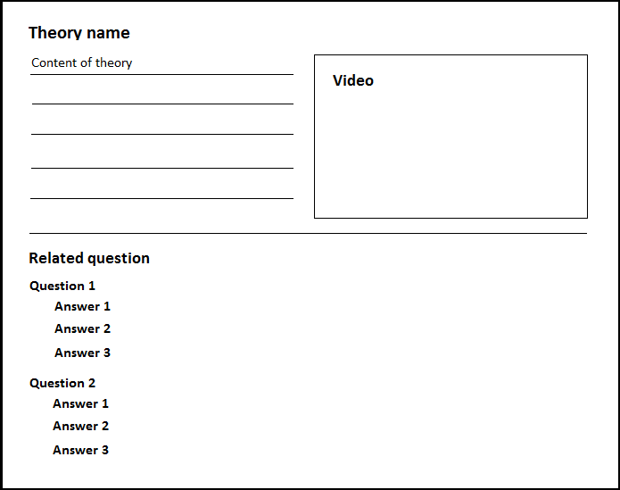
Software Requirement Specification
Functional Requirement
Theory Library

Slide 3
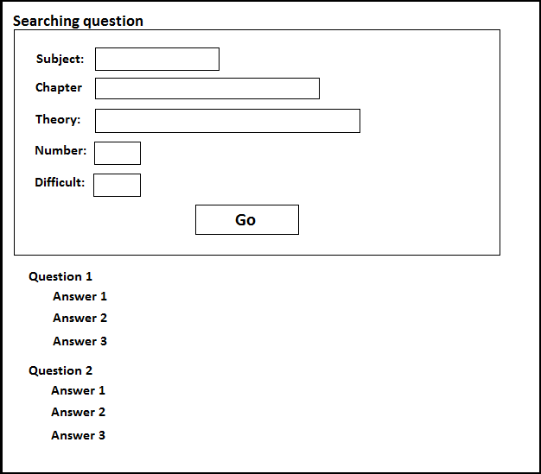
Software Requirement Specification
Functional Requirement
Exercise Library

Slide 4
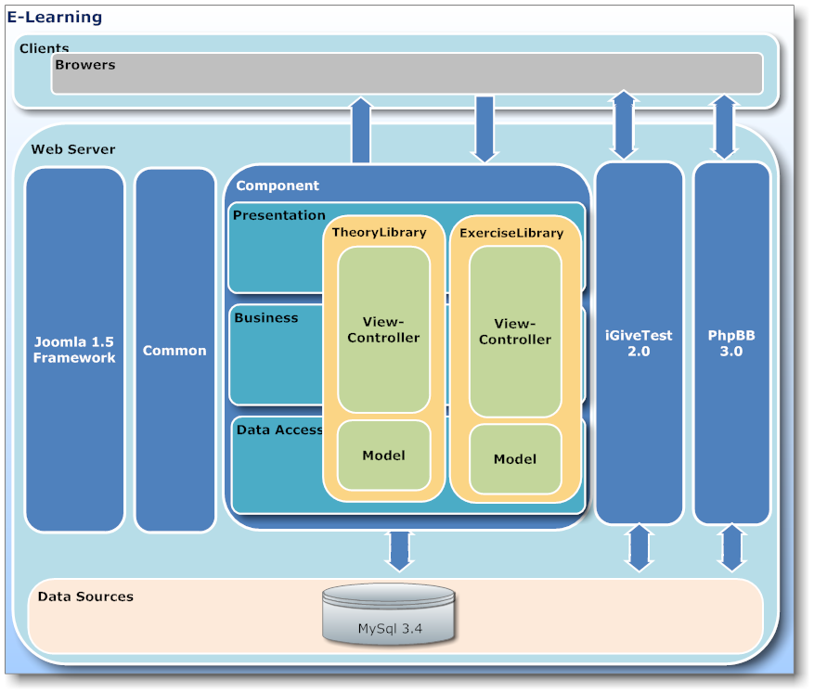
Software Requirement Specification
Functional Requirement
Code Combining

Slide 5
Software Requirement Specification
Non-functional Requirement
Maintainability
Availability
Testability

